Slide 1

Linkers Vs Loaders
Adnan Sadar
Nikhil Ravulaparthy
Pratik Fandade
Yash Jadhav
Akash Dhadiwal

Slide 2
Contents
Introduction
Linkers
Loaders
Comparison between Linkers and Loaders
Conclusion
References

Slide 3
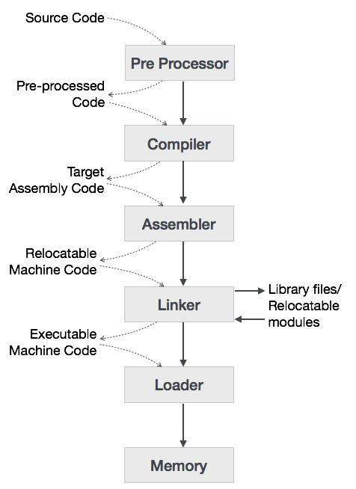
Flow of Execution
Overview of the Basics of a Compiler Design

Slide 4
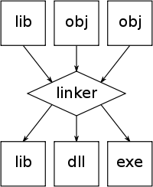
Linkers
Linking is a process in which the object file produced by the compiler is linked to many other library files.
One of the main tasks for linker is to make code of library functions available to your program.
A linker can accomplish this task in two ways using: Static Linking or Dynamic Linking

Slide 5
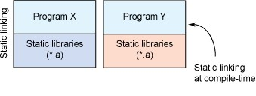
Static Linking
Static linking is the result of the linker copying all library routines used in the program into the executable image.
Static linking is done at compile time and is the last step of compilation.

Slide 6
Advantages/Disadvantages
Static linked files are larger in size.
Static linking takes constant load time.
There will be no compatibility issues with static linking.

Slide 7
Loaders
Card Deck
Main Memory
Loader is a system program that brings an executable file residing on disk into memory and starts it running.
Read executable file’s header to determine the size of text and data segments.
Initializes the machine registers including the stack pointer.
Tape
Assembler
Loader

Slide 8

Types of Loaders
Compile/Assemble and Go loader.
Absolute loader.
Relocating loader.
Direct Linking loader.

Slide 9

RESPONSIBILITIES OF A LOADER
Validate program for memory requirements, permissions, etc.
Copy necessary files, such as the program image or required libraries, from the disk into the memory
Copy required command-line arguments into the stack
Link the starting point of the program and link any other required library
Initialize the registers
Jump to the program starting point in memory

Slide 10
Assemble and Go loader
Compilation, assembly and link steps are not separated from program execution all in single pass.
The intermediate forms of the program are generally kept in RAM and are not saved to the file system.

Slide 11
Absolute loader
Gives the O/P programs as same as the “Compile and Go” Loader, only data is punched in form of cards, and directly placed in the memory.
Accepts machine language text and places it into the core location prescribed by the assembler.

Slide 12

Relocation loader
Execution of the object program using any part of the available and sufficient memory.
The object program is loaded into memory wherever there is room for it.
The actual starting address of the object program is not known until load time.

Slide 13
References
[1](The Morgan Kaufmann Series in Software Engineering and Programming) John R. Levine – Linkers and Loaders
[2]https://www.tutorialspoint.com/compiler_design/compiler_design_overview.htm#:~:text=An%20assembler%20then%20translates%20the,then%20the%20program%20is%20executed

